Slide 1

Introduction to
Hematology

Slide 2
Definition
Hematology (Greek Haema = Blood; logy = Study of).
Hematology is the branch of medical science that deals with the study of blood.
Blood, along with the cardiovascular system constitutes the Circulatory system .

Slide 3
Blood
Blood is a type of connective tissues.
Volume of blood is about 5 litters in an average adult male.
8% of the total body weight.
pH of blood in normal conditions is 7.4.
Volume of plasma is about 3.5 L
Blood is five times more viscous than water. It is mainly due to red blood cells and plasma proteins.

Slide 4
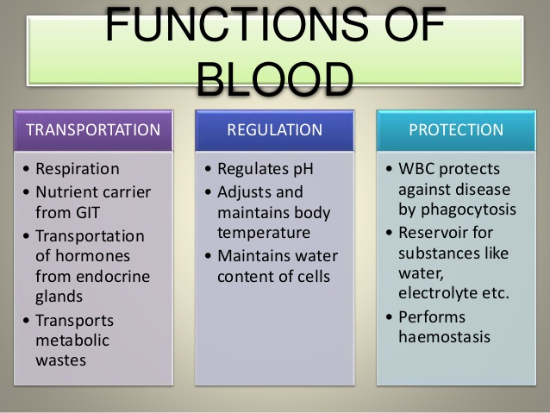

Slide 5
Component of the blood
It consist of :
1- Cells (cellular part).
2- plasma (fluid part ).
The cells are:
a- Red blood cells (RBCs) ,(erythrocytes).
b- White blood cells (WBCs), (leukocytes).
c- Platelets (thrombocytes).

Slide 6
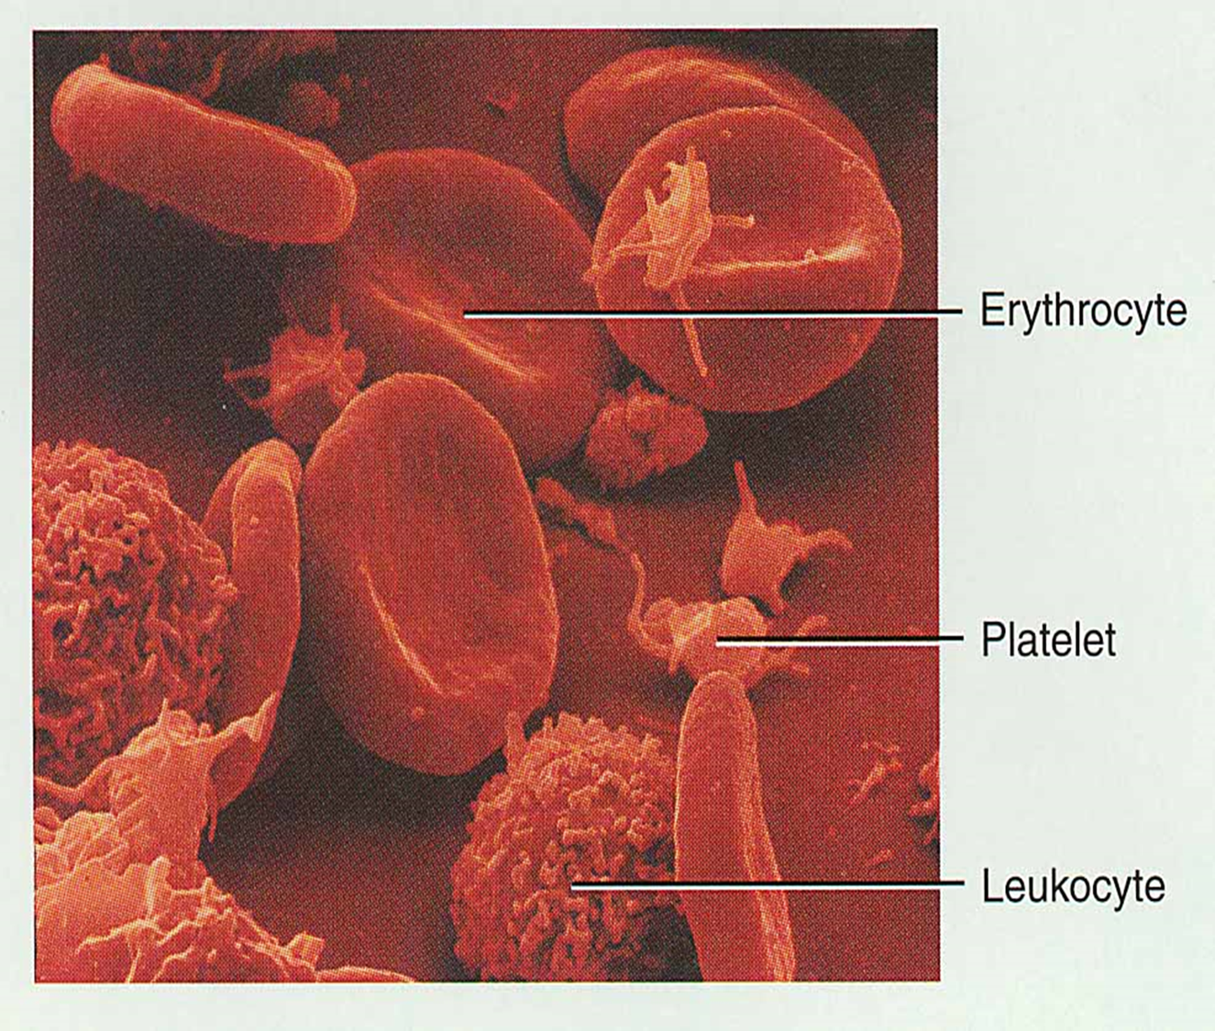

Slide 8
PLASMA
Plasma is the liquid part of blood.
It contains about 91% -- 92% of water and 8% -- 9% of solids.
The solids are the organic and the inorganic substances
**Serum
When the blood is collected in a container, it clots. In this process, the fibrinogen (protein) is converted into fibrin forming the blood clot.

Slide 9
i.e. serum contains all the other constituents of plasma except fibrinogen.
Fibrinogen is absent in serum because it is converted into fibrin during blood clotting.
Serum = Plasma – Fibrinogen

Slide 11
Hematopoiesis
Definition :-
Hematopoiesis: mechanism of blood cells formation , stages of development and differentiation.
It Include:
1- Erythropoiesis: formation of RBCs.
2- Leucopoiesis: formation of WBCs.
3- Thrombopoiesis: formation of platelets.

Slide 12
Sites of hematopoiesis
Fetal period :
-First trimester (3monthes): yolk sac.
-Second trimester (3monthes): liver & spleen.
-Third trimester (3monthes): red bone marrow.
After birth:
-Red bone marrow of all bones at first.
-Then the active red bone marrow becomes gradually replaced by inactive yellow marrow.

Slide 13
The sites during adult :-
At about age of 20y the red marrow is confined to:
-The flat bones (skull, scapula, ribs, sternum, vertebrae & iliac bone ).
-The end of long bones.
-Small bones of the hand & feet.

Slide 14
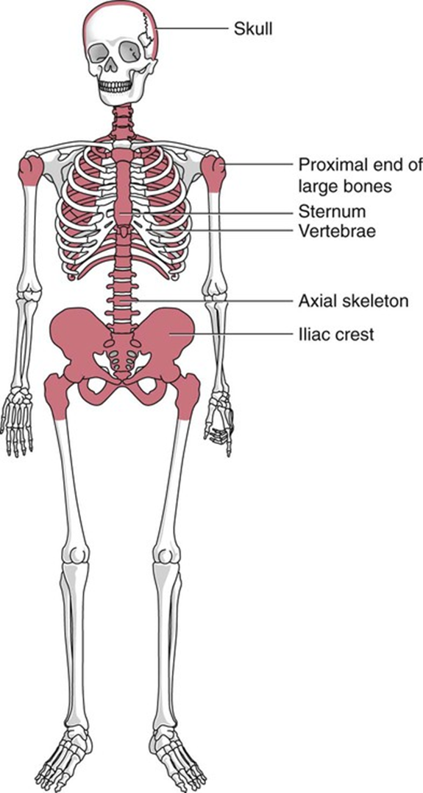

Slide 15
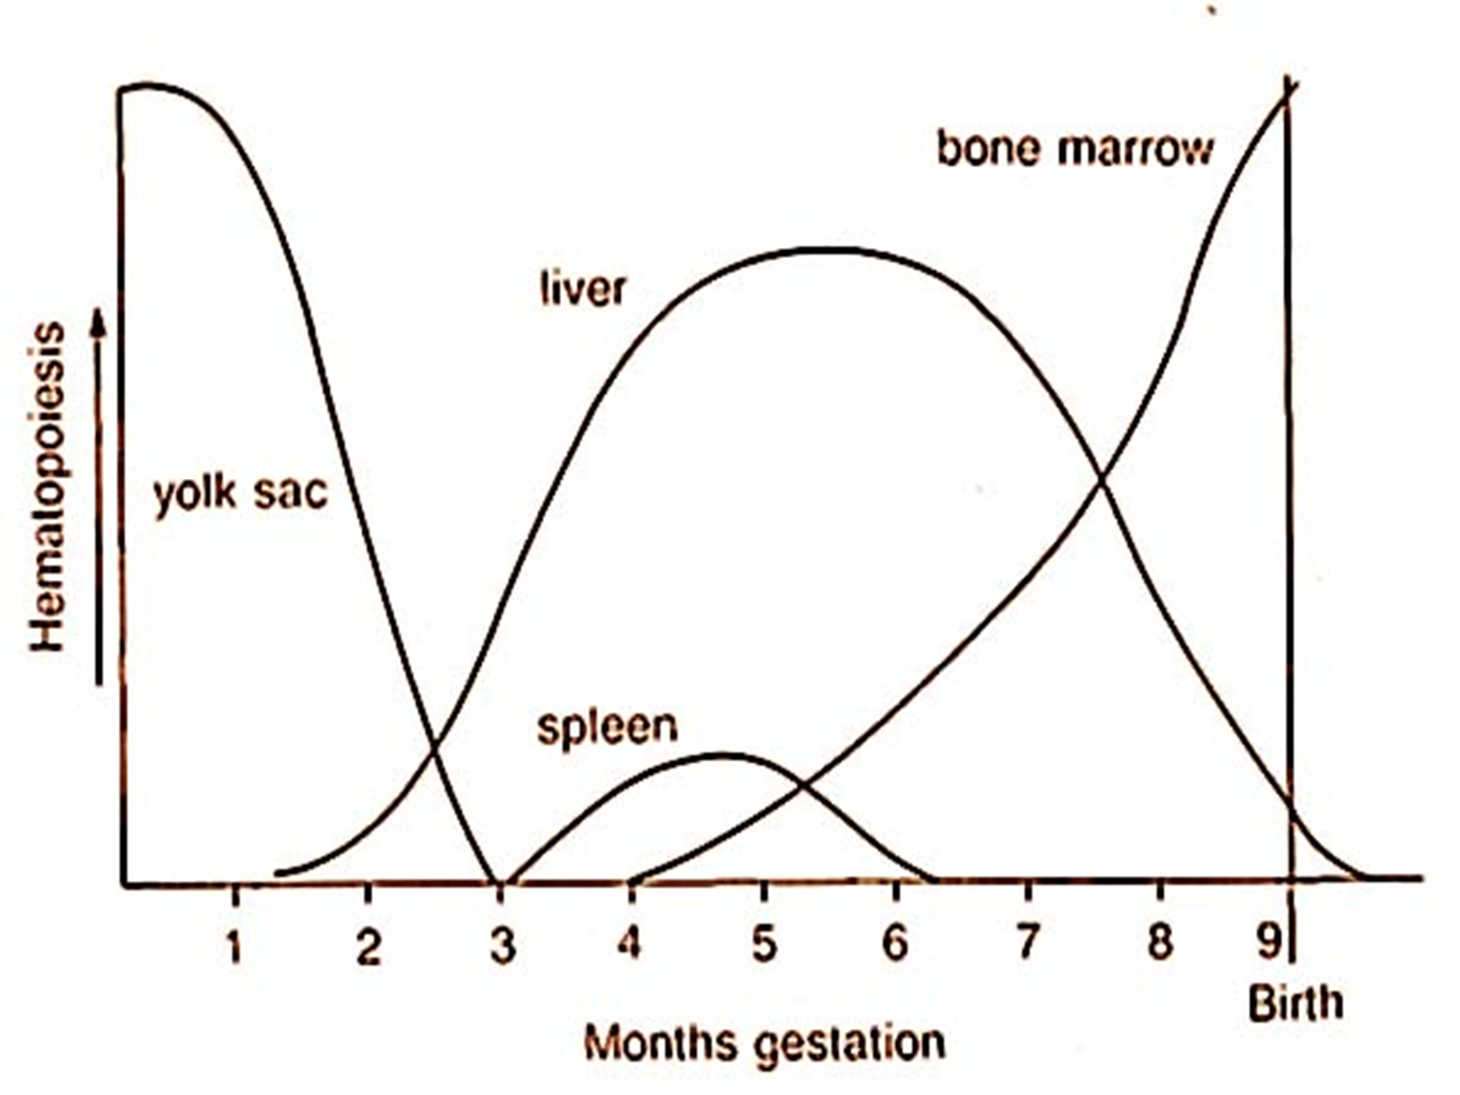

Slide 16
STEM CELLS
Stem cells are the primary cells capable of self-renewal and differentiating into specialized cells .
Hemopoietic stem cells are the primitive cells in the bone marrow, which give rise to the blood cells.

Slide 17
Hemopoietic stem cells in the bone marrow are called uncommitted pluripotent hemopoietic stem cells (PHSC)
It is defined as a cell that can give rise to all types of blood cells.

Slide 18
When the cells are designed to form a particular type of blood cell, the uncommitted PHSCs are called committed PHSCs which is restricted to give rise to one group of blood cells.

Slide 21
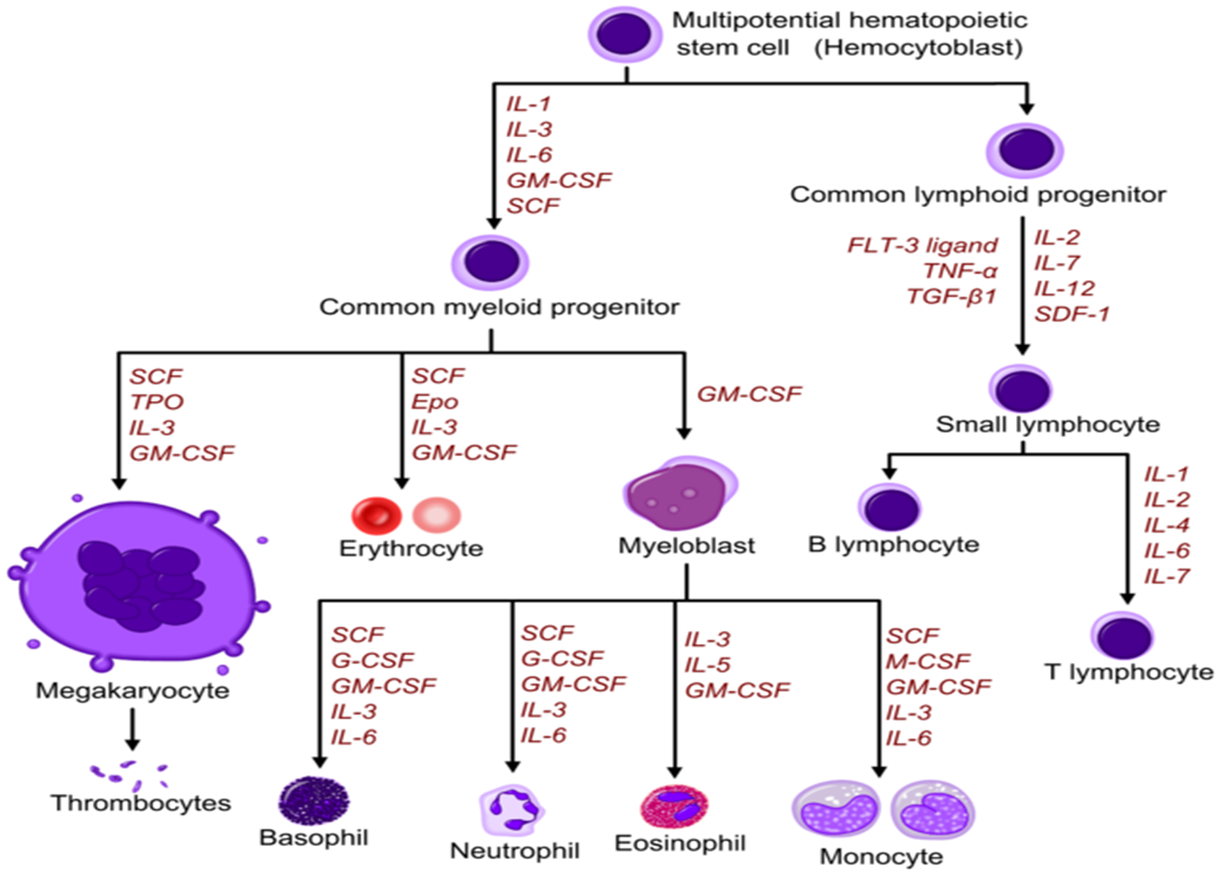

Slide 22


